Slide 1

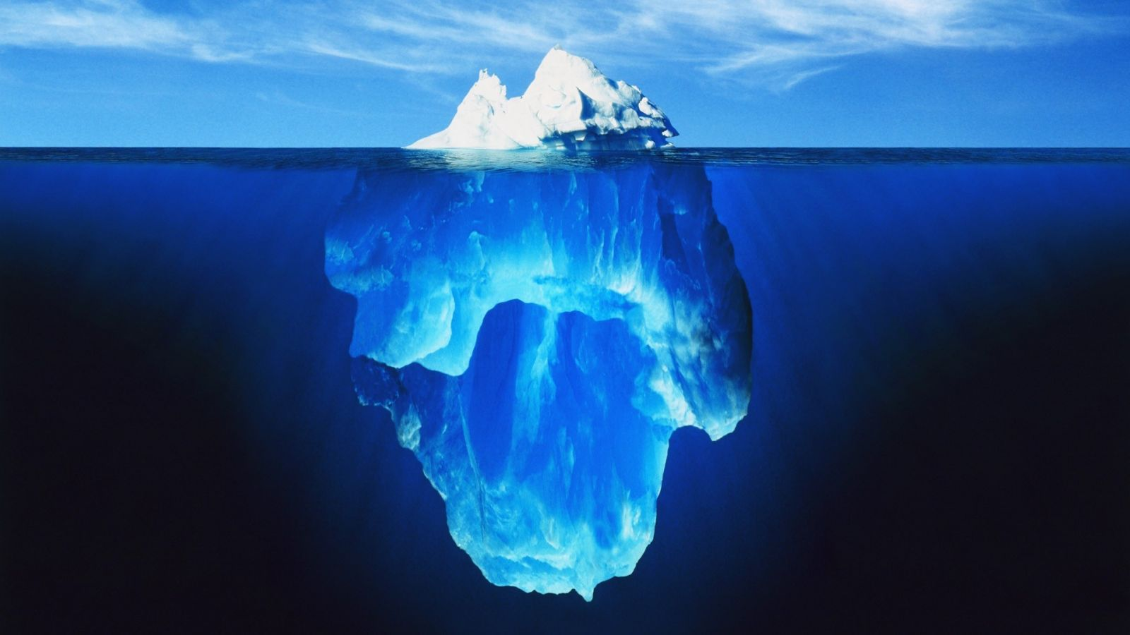
Cyber Warfare
CIS 4930 / CIS 5930
Offensive Security
Spring 2013

Slide 2
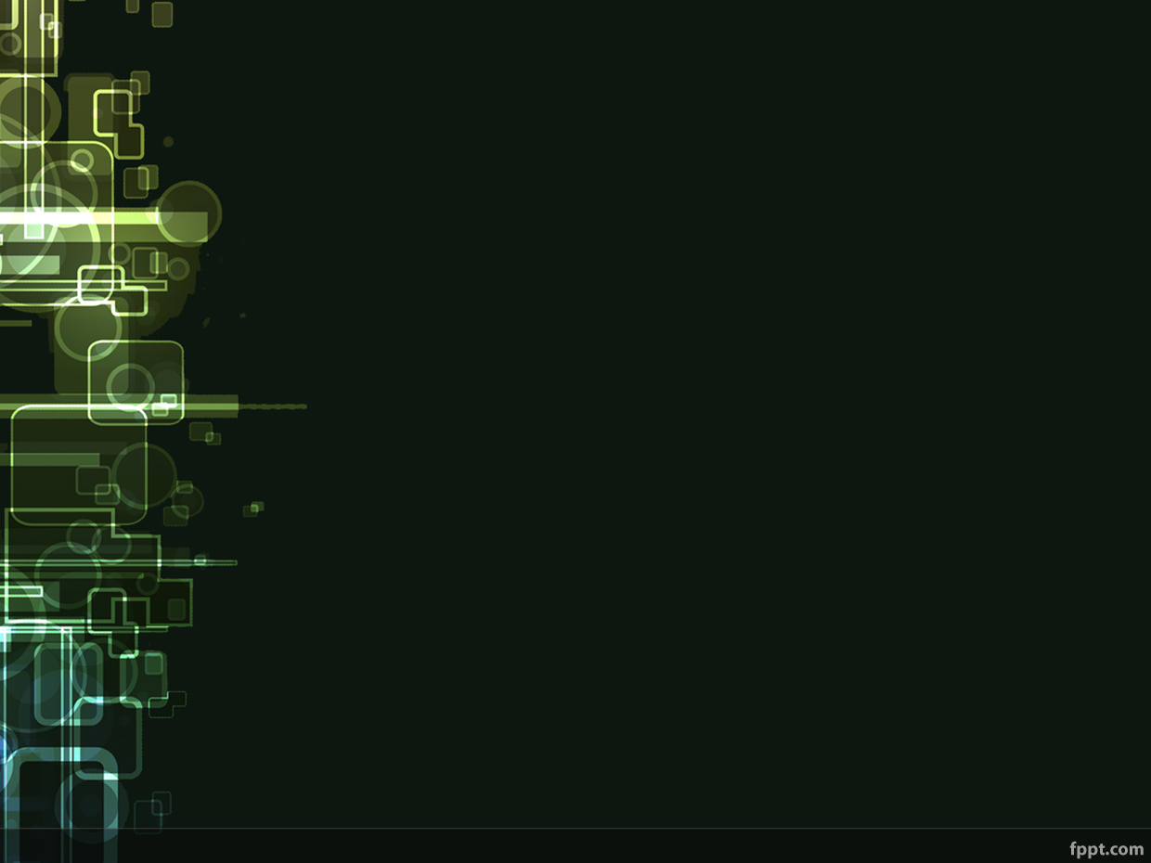
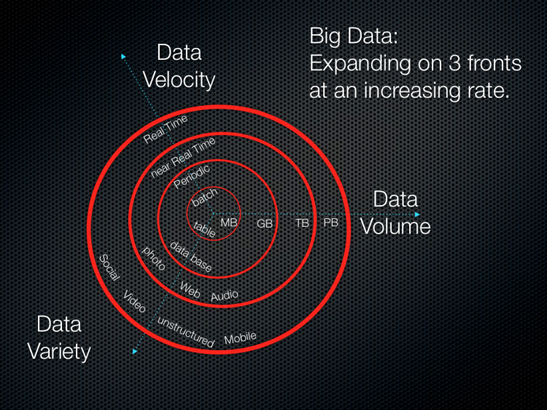
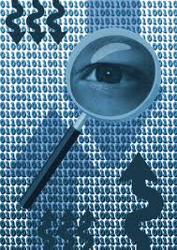
Here We Are
Big Data
The Cloud
Everything being connected

Slide 3
Disclaimer
The views presented here are not the opinions of my employers. Nor is most of this even my own opinion.
They are observations based on published news articles, unclassified reports, and well known events.

Slide 4
Outline of talk
A Brief history of modern cyber warfare
A high-level analysis of cyber warfare
Advanced Persistent Threats
Weaponization of 0days
Critical Infrastructure Problems and the Internet of Things
The Perception Problem
The Attribution problem
Nations vs "cyber militia" groups vs activists
Policy
The Future of War

Slide 5
Foreword
I consider the following events as part of the history of cyber war because they either:
Covert ops between nations / groups
part of civil war / revolution
govt vs "insurgents" / dissidents
a person who revolts against civil authority or an established government
Also, hardly a complete history

Slide 6
History of Cyber Warfare
Cyber warfare = politically motivated hacking to conduct sabotage / espionage
Sabotage -
disruptive activities (DDoS)
deletion of IP
dissenting opinions (Censorship)
destruction of property / industrial systems
Espionage -
"dox"ing targets
Stealing industrial IP
Spying on financial systems

Slide 7
History of Cyber Warfare
The Trans-Siberian Soviet Pipeline Sabotage, 1982
The pipeline used SCADA plans stolen from a Canadian firm by the KGB
See KGB operation "Line X"
CIA was tipped off before the theft
CIA had the company insert a logic bomb into their software for sabotage.
Resulting explosion was 1/3 the size of Hiroshima, showed up on NORAD's nuclear missile launch warning systems!

Slide 8
History of Cyber Warfare
Kosovo War, May 7 1999
a NATO jet bombed the Chinese Embassy in Belgrade, because it was providing communications support for the Yugoslav Army.
12 hours later the Chinese Red Hacker Alliance formed, and retaliated with thousands of cyber attacks against US govt websites.
Several other "patriotic" hacking groups have risen in China since
Culturally seen much differently than in the US

Slide 9
History of Cyber Warfare
Estonia, May 2007
A famous bronze statue of a World War II-era Soviet soldier was removed from a park
*Allegedly* a combo of russian govt organizations and individuals took down the Estonian internet.
Russian government denies any involvement
Some described it as the first war in cyber space
A month long national-scale DDoS and targeted hacking

Slide 10
History of Cyber Warfare
Russo-Georgian War, August 2008
Combined Kinetic and Cyber attacks against numerous Georgian government websites.
See the required reading about Georgia doxing Russian hackers
Operation Cast Lead, December 2008
Simultaneous cyber and kinetic attacks launched by Israel against Hamas.
Targets included both State and Non-state actors

Slide 11
History of Cyber Warfare
Coordinated Financial Sector DDoS, July 2009
Unknown attackers! Suspects include North Korea, United Kingdom?!
The Tulip Revolution II, 2009-2010
Months of unrest leading up to Kyrgyzstan's 2nd Tulip revolution. (Rigged prez election)
Govt cyber-crackdown on dissidents.
Gennady Pavlyuk (dissident journalist)
Email got hacked, and then tracked down and assassinated (caused outrage)
Govt then heavily attack dissident websites
Corrupt President overthrown

Slide 12
History of Cyber Warfare
Wikileaks, April 2010
Not cyber warfare, but a VERY important event
Largest known leak of classified documents ever
Shaped US information sharing policy
Was as big as 9/11 policy-wise
Woke everyone up on Insider Threats
Also had collateral damage

Slide 13
History of Cyber Warfare: Advanced Persistent Threat
Stuxnet, June 2010
June 2010 [source]
Targeted Iranian nuclear weapons enrichment centrifuges
Spread widely beyond intended target
Authors officially still unknown
widely believed to be USA / Israel

Slide 14
History of Cyber Warfare: Advanced Persistent Threat
GhostNET/幽灵网, August 2010
The USA officially announces that it has identified wide-scale Chinese military cyber espionage attacks aimed at American companies and government agencies
however: evidence classified
Heavy use of civilian computer experts in clandestine cyber attacks
[source from defense.gov]

Slide 15
History of Cyber Warfare
A R A B S P R I N G
The Jasmine Revolution, Jan 2011
Tunisian state controlled ISP (AMMAR) hacked user names and passwords to track down and kill dissidents (on mainly Facebook)
Anonymous fought back with DDoS on AMMAR
Corrupt govt overthrown
Libyan Revolution, Feb 2011
US Debated cyberwarfare attacks against Libyan anti-air defense systems, prior to air strikes. Declined out of fear to set precedent
Details classified [source]

Slide 16
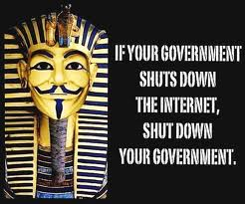
History of Cyber Warfare
A R A B S P R I N G
The Egyptian Revolution, Feb 2011
"Peaceful" revolution overthrowing dictator Hosni Mubarak
Revolution organized by Facebook, Twitter, and Youtube users
Govt. shut down the Internet
Anonymous attacks Egypt govt
Still activity to date

Slide 17
History of Cyber Warfare
Fun with Certificate Authorities
Comodo hack - March 2011[source]
Allegedly was perpetrated by actor(s) in Iran
compromised 20-25% of the internet
DigiNotar hack - July 2011 [source]
Also, allegedly was perpetrated by same actor(s) in Iran
Compromised the ENTIRE DUTCH GOVERNMENT's public facing websites
DigiNotar taken over by Dutch govt, then went bankrupt

Slide 18
History of Cyber Warfare
US Govt declares right to meet cyber attacks with military force - Nov 2011
http://www.reuters.com/article/2011/11/16/us-usa-defense-cybersecurity-idUSTRE7AF02Y20111116
Was very significant
First nation to establish a *rough* (war) declaratory policy regarding cyberspace activity.

Slide 19

History of Cyber Warfare
Honker Union (~Red Hacker Alliance) declares war on Japan - Nov 2011
Japan announced a plan to purchase Senkaku Islands (called Diaoyu Islands in China)
Honker union denounced the move and declared ware
Sustained DDoS, defacing, and sabotage-targeted attacks against Japanese:
central & local banks
universities
civilian companies
[source]

Slide 20
History of Cyber Warfare
NY Times hacked over story on top Chinese Communist leader's wealth - 2012-2013
NYT reported how Premier Wen Jiabao built a fortune of over $2 billion while in power
Chinese hackers repeatedly hacked NYT systems over 4 months [source]
stole reporters' passwords
attacked all the employees' personal accounts and systems
hunted for files related to NYT investigation
used a common strain of malware
seen before in other APT actions targeting US Military

Slide 21
A Note on Hacker Culture
In general, for hackers who make up the criminal element:
Hackers in the Western World
Often anti-government, and get in trouble with government
not patriotic, not nationalistic
often 99% of what they do is considered criminal
Hackers in the Eastern World
Often pro-government, and are ignored by government (as long as they play ball)
patriotic & nationalistic
countries often haven for cybercrime

Slide 22
History of Cyber Warfare: Advanced Persistent Threat
Stuxnet(2010), DUQU (2011), Flame(2012)...
Their authors legitimated the art of hacking as acceptable in the stage of international conflict - Michael Hayden (former director of N.S.A. and C.I.A.) [source]

Slide 23
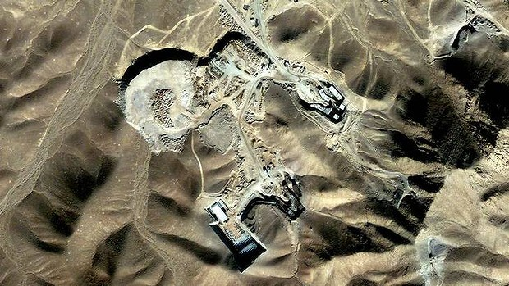
History of Cyber Warfare: APT Iran attacks July 2012
Rumors: Two Iranian uranium enrichment facilities hit again. Virus blares AC/DC's Thunderstruck at Max volume.
*Potentially an APT attack*
[Source]
Suspected Nuclear
Weapons Plant
Qom, Iran

Slide 24
History of Cyber Warfare: APT Iran attacks Jan 2013
Rumors again: Massive explosion at underground Fordow bunker felt over 3 miles away. *Potentially an APT attack*
Began weapon uranium enrichment in 2011
240 personnel trapped underground
When can cyber warfare be war crimes?

Slide 25
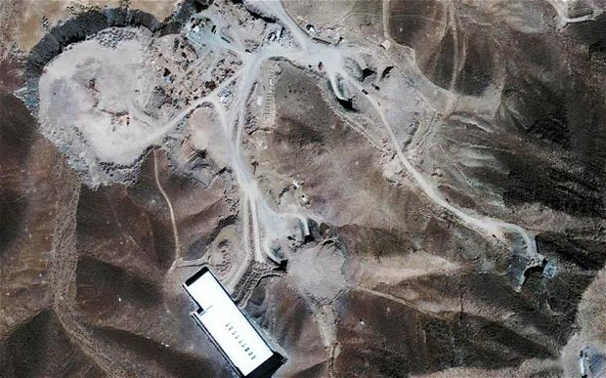
History of Cyber Warfare: APT Iran attacks Jan 2013
This site is under a mountain, because it is immune to bunker busters
Hence the APT suspicions

Slide 26
History of Cyber Warfare: Advanced Persistent Threat
"China’s economic espionage has reached an intolerable level and I believe that the United States and our allies in Europe and Asia have an obligation to confront Beijing and demand that they put a stop to this piracy. Beijing is waging a massive trade war on us all, and we should band together to pressure them to stop. Combined, the United States and our allies in Europe and Asia have significant diplomatic and economic leverage over China, and we should use this to our advantage to put an end to this scourge.”
— U.S. Rep. Mike Rogers, October, 2011
“It is unprofessional and groundless to accuse the Chinese military of launching cyber attacks without any conclusive evidence.”
— Chinese Defense Ministry, January, 2013
Source: http://intelreport.mandiant.com/Mandiant_APT1_Report.pdf

Slide 27
History of Cyber Warfare: Advanced Persistent Threat
Mandiant's report on APT1, Feb 2013
PLA Unit 61398 http://intelreport.mandiant.com/Mandiant_APT1_Report.pdf
Long term campaign aimed at:
industrial espionage
hundreds of terabytes of data
cyber physical sabotage probing/preparation
economic theft and sabotage
Video evidence of APT1 actors in action
http://intelreport.mandiant.com/
Doxed some actors
Precisely pinpointed attackers' location
dozens to hundreds of personnel

Slide 28
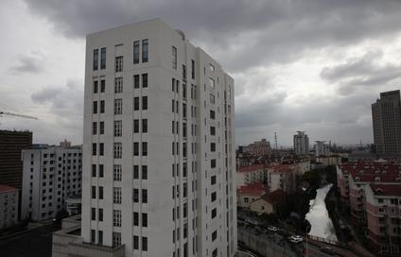
History of Cyber Warfare: Advanced Persistent Threat
Mandiant's report on APT1 (continued)
Groundbreaking - first report of its kind

Slide 29
History of Cyber Warfare: Advanced Persistent Threat
China claims to be the victim of US attacks as well - Feb 2013
http://threatpost.com/en_us/blogs/china-publicly-claims-be-victim-us-cyberattacks-022813
Prompted an interesting debate (next slide)

Slide 30
History of Cyber Warfare: Advanced Persistent Threat
On CNN: "Fareed Zakaria GPS," Feb 27, 2013 [source]
Fareed Zakaria asked:
"Mike [Hayden], the Chinese will say in response – or some Chinese will say – look, you guys do it, too. You know, why are you getting so heated up? You know, you ran the CIA and the NSA. What would be your response to them?"

Slide 31
History of Cyber Warfare: Advanced Persistent Threat
On CNN: "Fareed Zakaria GPS," Feb 27, 2013 [source] continued
To which Michael Hayden( former director of CIA and NSA) said:
Hayden: "Right. I freely admit that all nations spy. All nations conduct espionage. But some nations, nations like ours, self-limit. We steal other nation’s secrets to keep Americans safe and free. We don’t do it to make Americans rich or to make American industry profitable. And what the Chinese are doing is industrial espionage, trade secrets, negotiating positions, stealing that kind of information on an unprecedented scale for Chinese economic advantage. And that’s why I think our response should be in the economic zone. We need to make Chinese cyber behavior part of the overall portfolio of Sino-American relations and we need to begin to exact a price on the Chinese in the economic sphere for what it is they’re doing to us."

Slide 32

Rumors of War?
US ready to strike back against China cyberattacks
Feb 19, 2013

Slide 33
The "Underground"
or
Not-so-underground

Slide 34
Weaponization of 0days
Several companies do this around the world [source]
for their host nation and its allies
They discover 0days, develop exploits, and sell them exclusively to single clients
They do not ethically disclose the 0days
Keep the details and their clients secret
Some companies even provide a guarantee of working past system updates, and reformatting (SMM / BIOS rootkits)

Slide 35
0day Black(?) Market
What's the price for an 0day?
Platform specific? Independent?
one that allows:
remote code access?
denial of service?
privilege escalation?
Companies like VUPEN sell 0days and malware to governments
Wouldn't share the details of an exploit with a vendor for even $1,000,000 (A sandbox escape + remote code access)
“We don’t want to give them any knowledge that can help them in fixing this exploit or other similar exploits. We want to keep this for our customers.” - Chaouki Bekrar (Vupen's Chief Executive) [source]

Slide 36
0day Black(?) Market
Is this even a black market? Its publicly advertised on twitter!
How fast does the 0day market move?
Windows 8 and IE10 already hacked
http://thenextweb.com/microsoft/2012/11/01/security-firm-vupen-claims-to-have-hacked-windows-8-and-ie10/

Slide 37
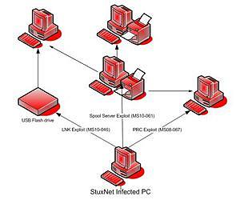
Stuxnet
Had 4 Windows 0day exploits
MS10-045/CVE-2010-0266
MS10-046/CVE-2010-2568
MS10-061/CVE-2010-2729 [source]
MS10-067/...
CVE-2010-2563
Analyzed by Symantec

Slide 38
Stuxnet
Had 4 Windows 0day exploits
MS10-045
MS10-046
MS10-061
MS10-067
Remote Code Execution
Thats super expensive to buy!!!
Privilege Escalation

Slide 39
Stuxnet
Recent Analysis reveals that Stuxnet (1.0's) C2 servers were online since 2005. (active for 5 years).
Further analysis reveals that a previous version of Stuxnet (dubbed "The missing link" v0.5) was in the wild before 2005.
Sources:
http://www.symantec.com/security_response/writeup.jsp?docid=2010-071400-3123-99
http://www.symantec.com/connect/blogs/stuxnet-05-missing-link
http://www.symantec.com/connect/blogs/stuxnet-05-how-it-evolved

Slide 40
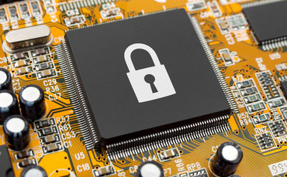
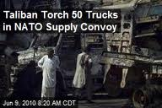
Supply Chain Attacks
Nation state controlled industries can ship malicious hardware
Or tamper with hardware transported inside its borders
Can be used in long term attack campaigns

Slide 41
State sponsored supply chain attacks?
Nation state controlled/aligned industries
Problems?
The state can influence the product's design, features (or secret features), and even... security (or lack thereof)
secret backdoors?
widespread espionage?
Many alledge that Huawei does some of this http://www.spiegel.de/international/business/the-secret-ways-of-little-known-chinese-telecoms-giant-huawei-a-875297.html

Slide 42
State sponsored supply chain attacks?
Conceptually, it's not unprecedented.
Trans Siberian Pipeline attack
A Cyber Physical Attack with kinetic impact
What if secret backdoors get hijacked?
by other nations?
Black flag ops?
by terrorists???
Can be a really bad idea...

Slide 43
State sponsored personnel attacks?
In 2012, it was reported that a foreign nation compromised a CEO's phone in a security checkpoint line
Stole credentials to perform industrial espionage, and spear phishing
[source]
Victim was totally unaware at the time

Slide 44
Imagine the
Supply Chain
for
The internet
of things

Slide 45
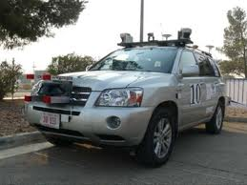
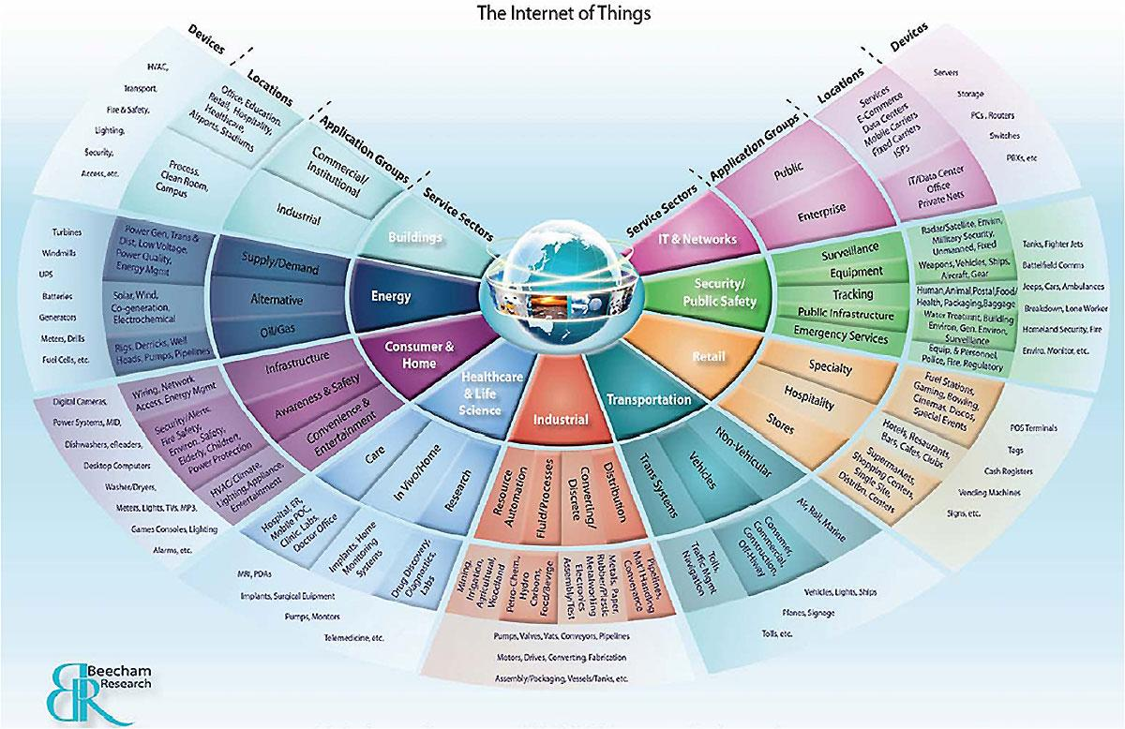
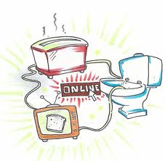
The Internet of Things
Will we make the same security mistakes when innovating smart technology?
Indubitably

Slide 46
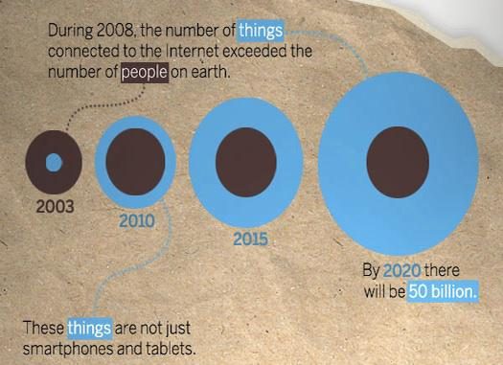
The Internet of Things
Source: http://www.jgsullivan.com/wp-content/uploads/2012/02/internet-of-things.jpg

Slide 47

Perception Problems
Law/policy-makers poorly understand technology
Thus fail to see real impacts that technology attacks can have
Everyone is looking for a:
Cyber Pearl Harbor
Cyber Katrina
Cyber 9/11

Slide 48
The Reality
The unsecured internet of things is creating the pathway to destructive attacks
"Attacks on digital systems that result in physical destruction will no longer require manual intervention" - Arthur Coviello Jr. RSA US 2013 Keynote speech
but FASTER intervention - i.e. automated smart defenses
[source]

Slide 49
Perception
Reality
Wise to note human nature
No one likes admitting that they got hacked
getting exposed...
getting hacked, bad for PR, business ...

Slide 50
Perception
Reality
What will it take to bridge the Gap?

Slide 51
Perception
Reality
Universally understood that what will bridge this gap is:
A Cyber 9/11
Cyber Katrina
Cyber Pearl Harbor

Slide 52
But .... Why?
Why do we have
to wait for the iceberg
to hit us for use to do something

Slide 53
Perception of Cyber Warfare...
The main problem with the history of warfare, and cyber warfare is:
The "cyber-pearl-harbor / cyber-katrina / cyber-9/11" perception...
Yet cyber warfare is unlike kinetic war
Need not be "won" with decisive, noticeable battles
There man even be no victory objective
Automation... / Malware...
no war fatigue!
War of long-term attrition is effective
"Cheat, lie, and rob them blind"

Slide 54
Cyber -> Kinetic Perception Problems
Hard for people to understand the kinetic impact cyber attacks can have.
Physical models help immensely to demonstrate
http://www.scientificamerican.com/article.cfm?id=a-tiny-city-built-to-be-destroyed-b-2013-01
put together by SANS institute's, Ed Skoudis (our textbook author)
a scenario: foreigners hack into the powerplant, reprogram + lock out the defenders.
goal to hack back into the systems, turn back on the power
How could this happen in real life?
Easily by supply chain attacks!

Slide 55
Nation State Cyber Warfare goals
Politics
sabotage currencies? influence revolutions? Influence other things? etc...
Hegemonic balance vs shift of super-power
Censorship / Stomping dissidence
Technological competition
IP theft
Enhancing defensive capabilities
See F35 blueprint theft from pentagon hacks
Supporting kinetic actions
Prevention of war? world war? nuclear?

Slide 56
The Anatomy of all-out,"provocative" Cyber Warfare (speculation)
Has yet to be seen, yet is anticipated by some lawmakers/leaders.
Targeted effort or pervasive cultural effort?
Large Scale DDoS
Target Critical Infrastructure / Finance?
Large scale espionage? (unlikely)
Large scale sabotage? (likely)
Combined with Kinetic action? (likely)
Would trigger massive reforms
And possibly trigger a kinetic war
WHY??

Slide 57
The Anatomy of long-term, attrition Cyber Warfare (speculation)
Has yet to be *seen*. Discovered during Cold War with Line X (smaller scale).
Targeted effort or pervasive cultural effort?
Large scale sabotage (unlikely)
Large scale espionage (likely)
Large scale IP theft
Target Critical Infrastructure / Finance?
The goal is to attack, yet avoid provocation
Shift the superpower status over time...

Slide 58
Collateral Damage
When is a Virus a War Crime??
Cyber-triggered kinetic actions can kill

Slide 59
Collateral Damage
Chevron hit by Stuxnet in 2010
are the Stuxnet authors responsible??
Anyone can repurpose and retarget (i.e. via http://www.shodanhq.com/) state-malware
Anti-terrorist informants/intel-assets are located and murdered
following identities compromised by Wikileaks
[source]
DigiNotar hacked, and went bankrupt

Slide 60
Critical Infrastructure
Cyber Physical Systems (CPS) control:
Air traffic control systems
Traffic light, rail road, and subway systems
The power grid/Communication systems
The manufacturing sector
Water systems (purification)
Centrifuges...
Here 0day's are called forever-day's
Cause they never get patched!
Taking out these, makes a country easier to invade...

Slide 61
The Attribution Problem
"Impossible" to accurately identify attackers (spoofing / proxies / TOR...)
Need hard evidence!!!
anonymous VPN [source]
Even so, if they are identified, think about the case of:
Civilian groups attacking other states
Can this even be considered an act of war?
Multinational groups (anon) attacking states
Cyber criminal havens (Russia / China) using criminal groups by proxy
It happens but cannot be proven to be the bidding of the host nation

Slide 62

The Attribution Problem
Black flag operations
Leaving comments in foreign languages in your attack code (Frame other nations / groups)
Using proxies in other countries
combine with "old-school" spies / spy assets
A true rabbit hole
Double Black Flag, Triple Black flag?!
Botnets / DDoS
UAV / Autonomous Cyber Warfare?

Slide 63
The Attribution Problem
Repurposed Stuxnets?
by other nations
by cyber criminals
A tornado of possibilities...

Slide 64
Scary?
How do we begin to make any policies with all this uncertainty?
FUD = Fear, Uncertainty, and Doubt.

Slide 65
"Policy"

Slide 66
US Cyber Warfare Legislation / Policies
Cyber technology / the internet has forced congress to update almost every aspect of law
Taxing the internet?
Protecting children
Piracy vs theft vs copying?
Robbery
Privacy (or total lack-thereof)
But what about War-declaring policies?
Significant challenges

Slide 67
THE Convention on Cybercrime
The 2001 Budapest Convention on Cybercrime [source]
first international treaty seeking to address computer crime and internet crimes by harmonizing laws, and
improving investigative techniques
was a failure
many believe TPM (Trusted Computing) is the way forward
cooperation among nations
As of Oct 28, 2010- 30 states had signed AND ratified
USA,
16 states had signed signed but NOT ratified

Slide 68
US Govt Internet Responsibility
DoD is responsible for .mil
NSA / CYBERCOM
DHS is responsible for .gov
DoD & DHS expected to cooperate
a formidable task
But who for .com? the 85-90%???
Is the private sector expected to cooperate with DHS / NSA?
Trust issues?
What if compromised priv sector systems are used to attack .mil or .gov?
Google *allegedly* went to the NSA for help after being attacked by China

Slide 69
Private Sector & Government
Cooperation is hindered by corporations unwillingness to share with competitors or govt:
proprietary information (about their systems, tech, etc..)
Government is unable to disclose:
classified data
sensitive data
Then the inherent trust issues.
Some companies fear backlash from customers for cooperating with the NSA/DHS/etc...

Slide 70
Related US Legislature A history of failure
1980's Several laws were proposed to weaponize cryptography
to perhaps make even the use of it result in classified material
Any function that renders encrypted data, makes that data classified
madness!
Luckily this did not pass
Still cryptography is affected by import/export laws in all nations

Slide 71
Related US Legislature A history of failure
2011 Stop Online Piracy Act (aka SOPA, "E-PARASITE Act") & Protect IP Act (PIPA)
Draconian approach to regulate the DNS system to black-list unapproved websites
for the purpose of stopping piracy
piracy poorly defined, and manipulatable
Would have allowed for political and corporate censorship of the internet
madness!
Luckily this did not pass

Slide 72
Related US Legislature
"Kill Switch Bill" aka "Protecting Cyberspace as a National Asset Act of 2010"
Sen Lieberman (I), Collins (R), and Carper (D)
Executive branch could shut down parts of the internet
Not signed into law (yet)

Slide 73
Related US Legislature
The Cybersecurity Act of 2012
set cybersecurity standards for critical infrastructure operators and would have encouraged companies and the government to share information about cyber threats.
to raise situational awareness for critical infrastructure
water, power, sanitization, traffic, etc...
Opposing groups cited privacy concerns
Similar to CISPA....
but bill prohibits sharing citizen data with military and intelligence community groups (NSA)
Did not pass

Slide 74
Related US Legislature
CISPA - Cyber Intelligence Sharing and Protection Act - 2011-2013
"To provide for the sharing of certain cyber threat intelligence and cyber threat information between the intelligence community and cybersecurity entities, and for other purposes."
"carves a loophole in all known privacy laws and grants legal immunity for companies to share your private information" - The EFF https://www.eff.org/cybersecurity-bill-faq
passed the house in April 2012
Not passed in Senate
Reintroduced Feb 2013
Being considered now

Slide 75
Related US Legislature
CISPA - Cyber Intelligence Sharing and Protection Act - 2011-2013
Requires ISPs and websites to track a vast amount of info on their users, for the purposes of sharing with the govt
This costs ISPs money
Diskspace + time = $$$cost
Act allows resale of info to anyone
as long as it can be termed "for cybersecurity purposes"
... But wait! this viagra spam email has nothing to do with cybersecurity!

Slide 76
Related US Legislature
CISPA - Cyber Intelligence Sharing and Protection Act - 2011-2013
Circumvents
the Cable Communications Policy Act,
the Wiretap Act,
the Video Privacy Protection Act,
and the Electronic Communications Privacy Act
these laws expressly allow lawsuits against companies that go too far in divulging your private information
CISPA does not require any notification of a user for mishandled /disclosed data
Remember, not yet passed but being voted on now

Slide 77
Policy Hurdles
The following discussion is largely inspired and taken from Professor Michael Nacht's 2011 work: "The Cyber Security Challenge"
He has invaluable insight into the inner workings of government, the executive branch, and foreign policy
Many consider him a living "National Treasure"
His framing of the policy hurdles to secure cyber space are what we will consider

Slide 78
Policy
1) Declaratory Policy:
While we do reserve the right to respond to cyber attacks with kinetic force,
The US govt has no official policy publicly communicating what it would do or not do in the event of a major cyber attack against:
military forces,
command and control systems,
electrical power grid
financial networks,
or other elements of military power or critical infrastructure
source [1]

Slide 79
Policy
2) Deterrence Policy:
Are the nuclear age deterrence tactics applicable in cyber space? They have been quite successful in averting global war.
No attribution like in the case of a ICBM launch
Even if attacks are detected, damage is determined later
trivial damage vs profound damage?
what if the detection systems are attacked???
source [1]

Slide 80
Policy
3) Policies on Authorities and Responsibilities:
Any response to a foreign cyber attack would surely involve some violation of that nation's sovereignty
What legal basis does the US have to conduct such operations?
Establishing this basis for traditional kinetic actions takes weeks or months!!!
How can we bridge this time lag??
source [1]

Slide 81
Policy
4) Policy Guarantees of Civil Liberties
Given the attribution problem, how do we formulate policies that still guarantee the civil liberties of our citizens?
The problem with the "Kill Switch" bill
5) Oversight policies
What role does congress have in overseeing US cyber activities taken by the Executive branch?
Time lag concerns & hinderance of sec.
Senate select subcommittee?
source [1]

Slide 82
Policy
6) Policies for international consultations, negotiations, and agreements
The US shares select info on cyber security with key allies
Should it broaden the audience?
What *should* we gain from cooperation?
Formal treaties
are there any advantages? or bad idea?
Constraining?
source [1]

Slide 83
Policy
7) Cross domain deterrence and response policies
If the US experienced a major cyber attack, the response need not be in cyber space.
What types of rules should govern the response?
political rules, economic rules (sanctions?), diplomatic, military?
Must consider proportional or escalatory response
And the world perception of the response
source [1]

Slide 84
Policy
8) Policies to strengthen private sector & government cooperation
How can this best be achieved?
to protect critical infrastructure, financial sector, etc..
Who would lead this initiative?
Executive branch?
Department of Commerce?
FBI/DHS?
source [1]

Slide 85
The Now
"We are still in the infancy of understanding cyber security"
..."analogous to the late 1940s in the nuclear age."
We hardly understood the rules, and the game back then.
Will it take us more than a decade as well this time?
source [1]

Slide 86
The Future
Much more state-sponsored cyber attacks / malware??
Then repurposed by cyber criminals!
Cyber Counterintelligence!
Think how this might affect public trust
Can we automate it?
similar to honeypots
but can it be actionable??
IPv6 and Attribution
Think what IPv6 means for this
Does it even help??

Slide 87
Alice in Wonderland
Truly a crazy rabbit hole

Slide 88
The needs of the Security World
More Situational Awareness
Big data analytics
More Threat Intelligence
Big data + threat analysts
More harmony on cyber law
Universal law on IP rights!
Universal law on rules of engagement
More awareness of assets
Internet of things
Better tools
for understanding normal behavior
of your enterprise
of your enemies

Slide 89
Sources
[1] Nacht, Michael. "THE CYBER SECURITY CHALLENGE". Goldman School of Public Policy - UC Berkley. 2011
<http://gspp.berkeley.edu/news-events/bpn_docs/PolicyNotes-2011Spring-web.pdf>

Slide 90

Questions?

Slide 91
Adversarial Execution Environments (A.X.E.)
A project I worked on previously...
(Project F.I.R.E.A.X.E.)
The goal is to develop OS and Software to perform a task on hardware that you MUST assume is not trustworthy
cannot trust hardware, you don't control 100% of the supply chain!!
secret backdoors (root, user shells!!!)
Challenging!
Impossible??

Slide 92
Adversarial Execution Environments (A.X.E.) Programming
Useful tools/techniques:
a crypto processor that you control (100% of its supply chain)
signed code
process white-listing
hardcore least permissions model
captchas
strip out all bloatware
anti-RE / anti-forensics / obfuscated all throughout
Sounds crazy, because it somewhat is!

